Slide 1



OSCILLATION 3.0
IDEATHON
PITCH DECK

Slide 2

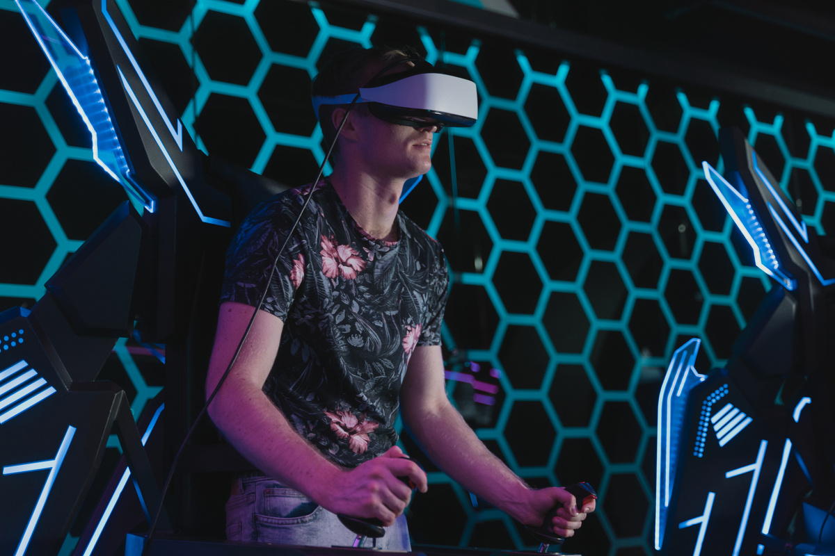

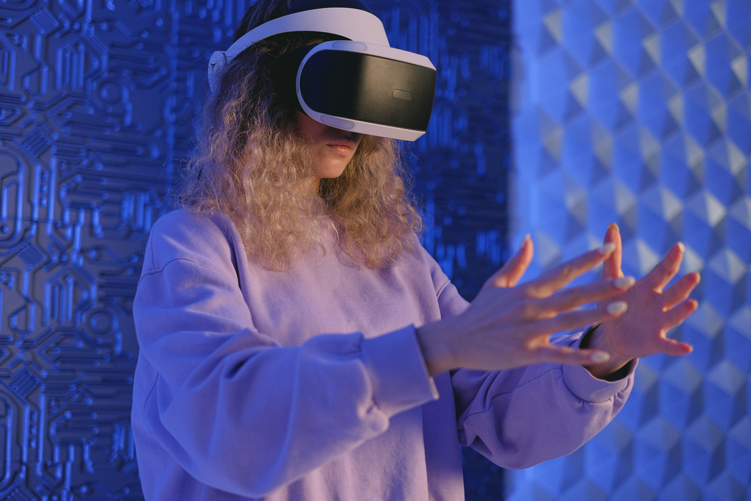
OUR TEAM
Aaron Loeb
Olivia Wilson
Juliana Silva
Juliana Silva
Team Member
Team Member
Team Member
Team Member

Slide 3
PROBLEM STATEMENT

Slide 4


PROPOSED SOLUTION

Slide 5

IDENTIFIED GAPS

Slide 6
NOVELTY ( HOW THE IDEA IS INNOVATIVE )

Slide 7

MARKET ANALYSIS AND COMPETITORS

Slide 8
REVENUE GENERATION

Slide 9

THANK YOU

